Slide 1
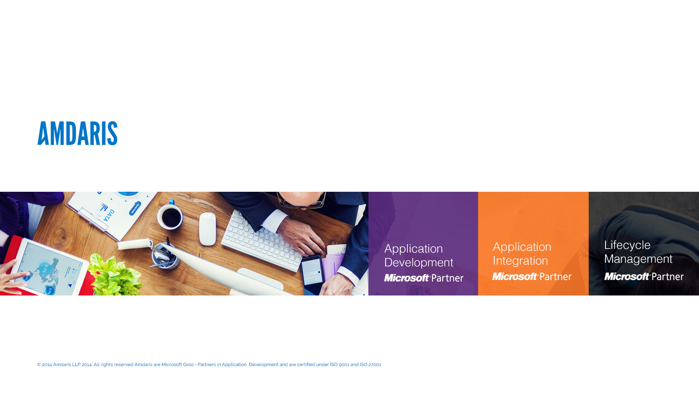
Containerized Single Page Applications with .NET backend
Marian Bejenari
Former student of the Technical University of Moldova
Notes:
Ask about levels of students, and take in account when explaining things during presentation

Slide 2


Agenda
Why it’s time to move from MVC
1
Demo
2
What are the solutions for frontend
3
Demo
4
Demo
6
Docker in development and production
7
Final Demo
8
What are the solutions for backend
5

Slide 3
MVC
Controller
Updates
User action
Updates
View
Reads / Binds
Model

Slide 4
MVC
Controller
Rebuilds
User action
Updates
View
Reads
Model
Notes:
View has to be recreated on each model update.
View does not bind anymore to model, so the changes are only applied on user actions.
New View is being sent over network for each user action.
Your Web MVC framework is not really MVC.

Slide 5
Demo life without Javascript.
Notes:
Yes, you can add some ajax here and there but with application growth it will become more of a single page application without the help of any spa frameworks which can be quite complex.

Slide 6
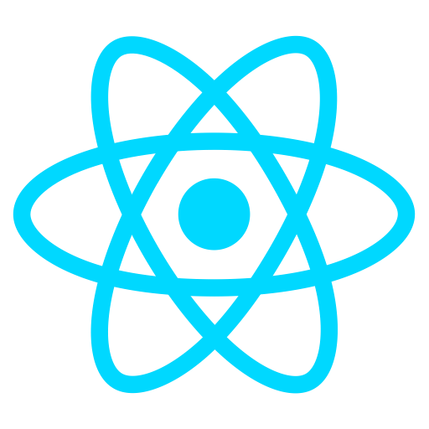
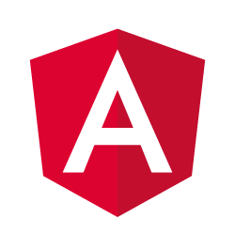
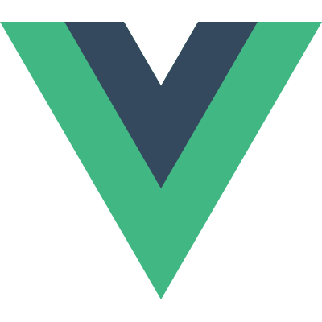
Frontend Solutions

Slide 7
React
View oriented
Good at scale, easy testing and diagnosis
Web and native apps

Slide 8
Angular
All out of the box
Great tooling and typescript adoption
Best for large or very interactive apps

Slide 9
Vue.js
Best of two worlds
Simplicity in syntax and project setup
Fast rendering and small size

Slide 10
Demo life with Javascript

Slide 11
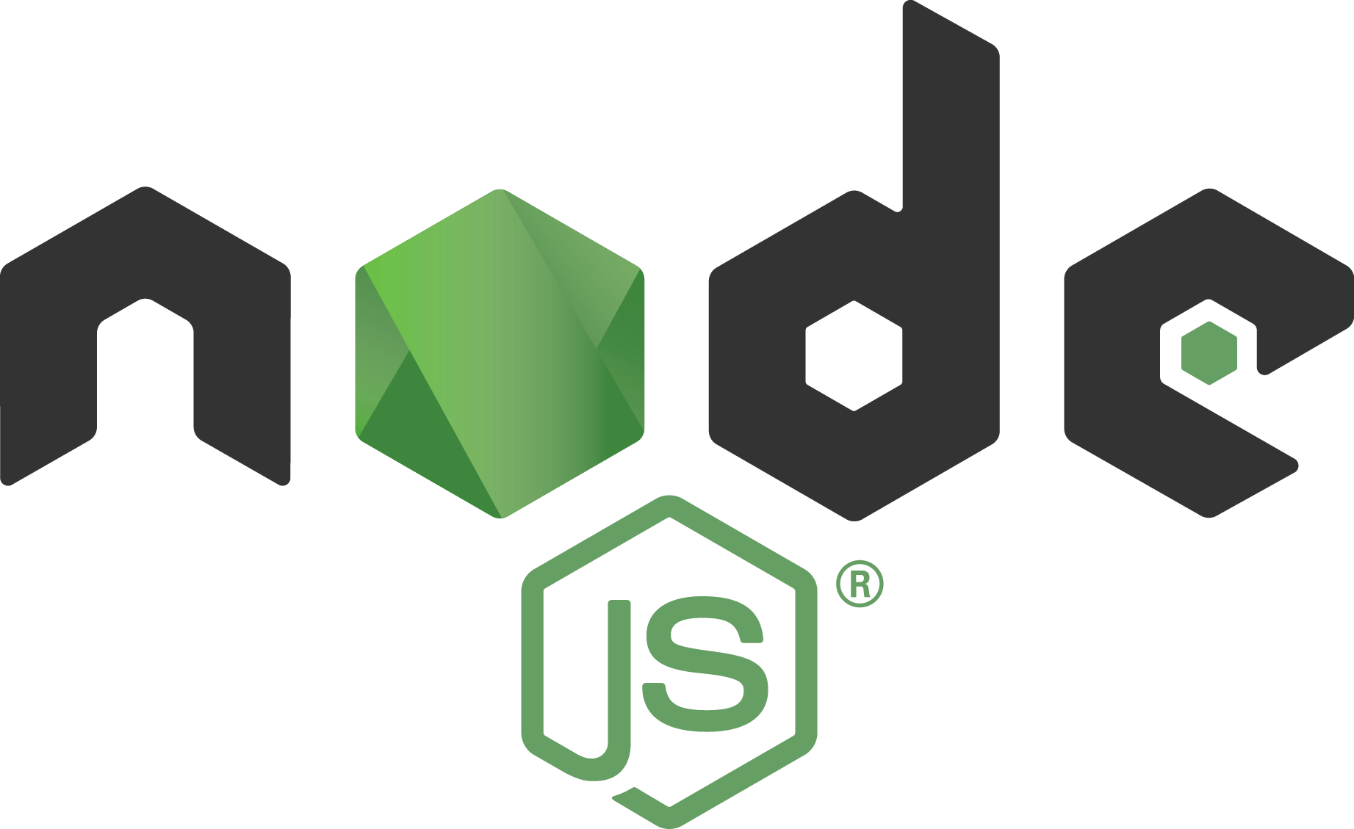
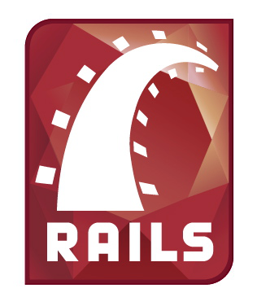
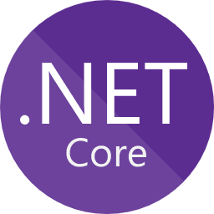
Backend Solutions

Slide 12
ASP.NET Core
Open Source
Cross-Platform
Blazingly Fast
Bunch of features out of the box
Great Documentation

Slide 13
Demo ASP.NET Core 2.0

Slide 14
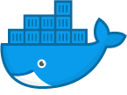
Docker
What is a Container?
Containers are a way to package software in a format that can run isolated on a shared operating system.

Slide 15
Development
Compatibility & maintainability
Host machine sanity
CI efficiency
Notes:
Parity, it runs the same on all the machines, notebook, PCs, Macs, deployment server etc.
You don’t need to clutter your system with exotic dependencies for a single project, or having multiple version of same language installed in your system, this can be delegated to docker.
Used in CI builds and automated testing - The same images we're using to deploy and test the software locally is used by CI to build and test the software. This makes it less likely of bugs specific to the quirks in somebody's local environment.
Ease of distribution of environments to teammates - recently we had a completely new stack of software that we had to start maintaining. We only had to produce the stack once in Docker and distribute it among the team instead of documenting the tools and process to install the multitude of software. Documents are often forgotten about and only tested when a new member joins the team--often the instructions don't work anymore.

Slide 16
Production
Compatibility & maintainability
Rapid Deployment
Continuous Deployment & Testing
Multi-Cloud Platform
Notes:
Try to add a demo of deploying same container to both Azure and Google Cloud
Compatibility & maintainability
Eliminate the “it works on my machine” problem once and for all. One of the benefits that the entire team will appreciate is parity. Parity, in terms of Docker, means that your images run the same no matter which server or whose laptop they are running on. For your developers, this means less time spent setting up environments, debugging environment-specific issues, and a more portable and easy-to-set-up codebase. Parity also means your production infrastructure will be more reliable and easier to maintain.
Rapid Deployment
Docker manages to reduce deployment to seconds. This is due to the fact that it creates a container for every process and does not boot an OS. Data can be created and destroyed without worry that the cost to bring it up again would be higher than affordable.
Continuous Deployment & Testing
Docker ensures consistent environments from development to production. Docker containers are configured to maintain all configurations and dependencies internally. So, you can use the same container from development to production making sure there are no discrepancies or manual intervention. If you need to perform an upgrade during a product’s release cycle, you can easily make the necessary changes to Docker containers, test them, and implement the same changes to your existing containers. This sort of flexibility is another key advantage of using Docker. Docker really allows you to build, test and release images that can be deployed across multiple servers. Even if a new security patch is available, the process remains the same. You can apply the patch, test it and release it to production.
Multi-Cloud Platforms
This is possibly one of Docker’s greatest benefits. Over the last few years, all major cloud computing providers, including Amazon Web Services (AWS) and Google Compute Platform (GCP), have embraced Docker’s availability and added individual support. Docker containers can be run inside an Amazon EC2 instance, Google Compute Engine instance, Rackspace server or VirtualBox, provided that the host OS supports Docker. If this is the case, a container running on an Amazon EC2 instance can easily be ported between environments, for example to VirtualBox, achieving similar consistency and functionality. Also, Docker works very well with other providers like Microsoft Azure, and OpenStack, and can be used with various configuration managers like Chef, Puppet, and Ansible,etc.

Slide 17
Final Demo
Notes:
https://github.com/Kerego/ict-2017-amdaris

Slide 18
Call
Go and build your first SPA
If you need a backend for it, try ASP.NET Core
If you liked it, go deeper, try adding Docker

Slide 19
Links
ASP.NET Core https://docs.microsoft.com/en-us/aspnet/core/
Angular https://angular.io/guide/quickstart
Presentation & Sources https://github.com/Kerego/ict-2017

Slide 20
Thank You
Notes:
Go to http://ict-2017.azurewebsites.net and give a like if you liked the presentation

